Slide 1
Comparison of String Matching Algorithms for Biological Sequences SHAHAN MALIK
.

Slide 2
USE OF STRING MATCHING
String matching is used to compare two strings .

Slide 3
INTRODUCTION
String matching is used for locating nucleotide or amino acid sequence patterns in the biological sequence databases. DNA sequences have an alphabet of four characters, and amino acid sequences have an alphabet of 20 characters. Because the total number of sequences is rapidly increasing.

Slide 4
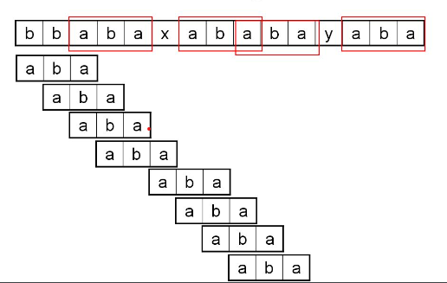
EXAMPLE

Slide 5
Abstract
Exact matching of single patterns in DNA and amino acid sequences is studied. We performed an experimental comparison of algorithms presented in the literature. In addition, we introduce new variations of earlier algorithms.

Slide 6
Variations for Amino Acids
The q-gram approach is valid also for larger alphabets, although with a larger alphabet the optimal value of q is smaller. A larger alphabet size required only minor changes to the algorithm.

Slide 7
Variations of Our Algorithm
Our Earlier Algorithm
Our algorithm is a modiﬁcation of the Boyer–Moore–Horspool algorithm for the DNA alphabet. Instead of inspecting a single character at each alignment of the pattern, the algorithm reads a q-gram and computes an integer

Slide 8
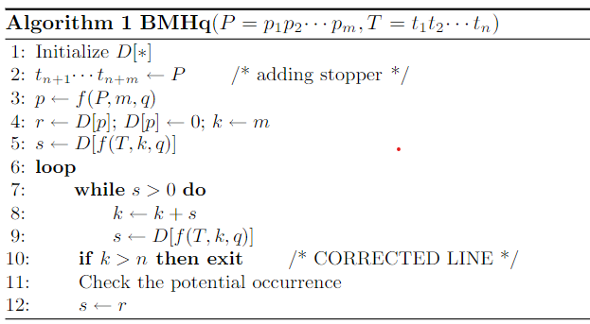
.

Slide 9

.

